Slide 1

The Web, The Internet, and Network Protocols

Slide 2


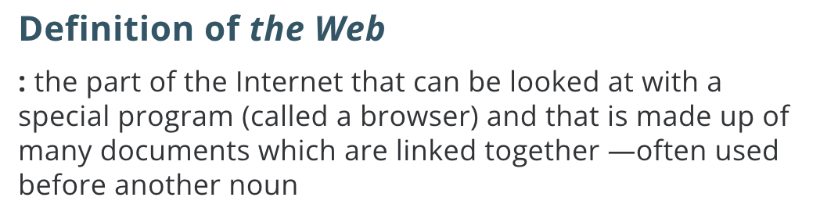

Slide 3

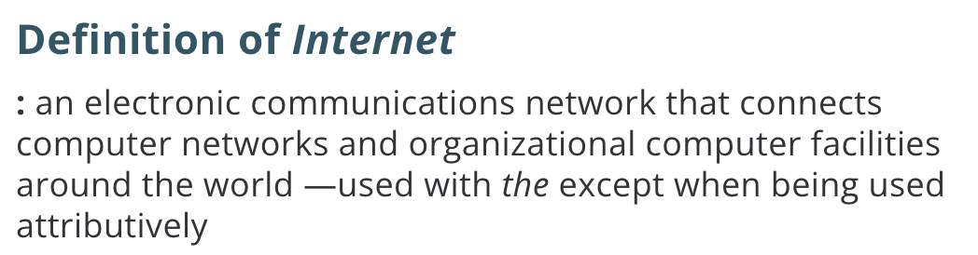

Slide 4
The Web
The Web [link]
HTTP (Hypertext Transfer Protocol) [link]
DNS (Domain Name System) [link]
HTML (Hypertext Markup Language) [link]
CSS (Cascading Style Sheets) [link]
JavaScript [link]

Slide 5
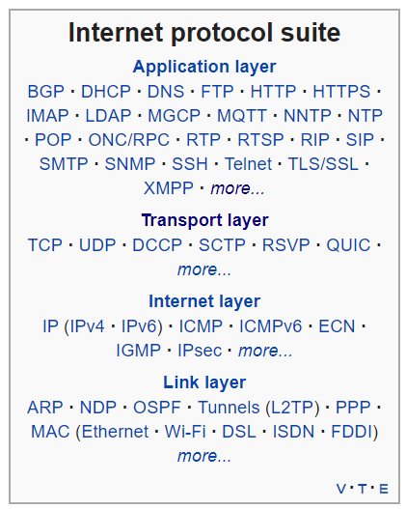
The Web
The Web [link]
HTTP (Hypertext Transfer Protocol) [link]
DNS (Domain Name System) [link]
HTML (Hypertext Markup Language) [link]
CSS (Cascading Style Sheets) [link]
JavaScript [link]
Internet Protocol Suite [link]

Slide 6
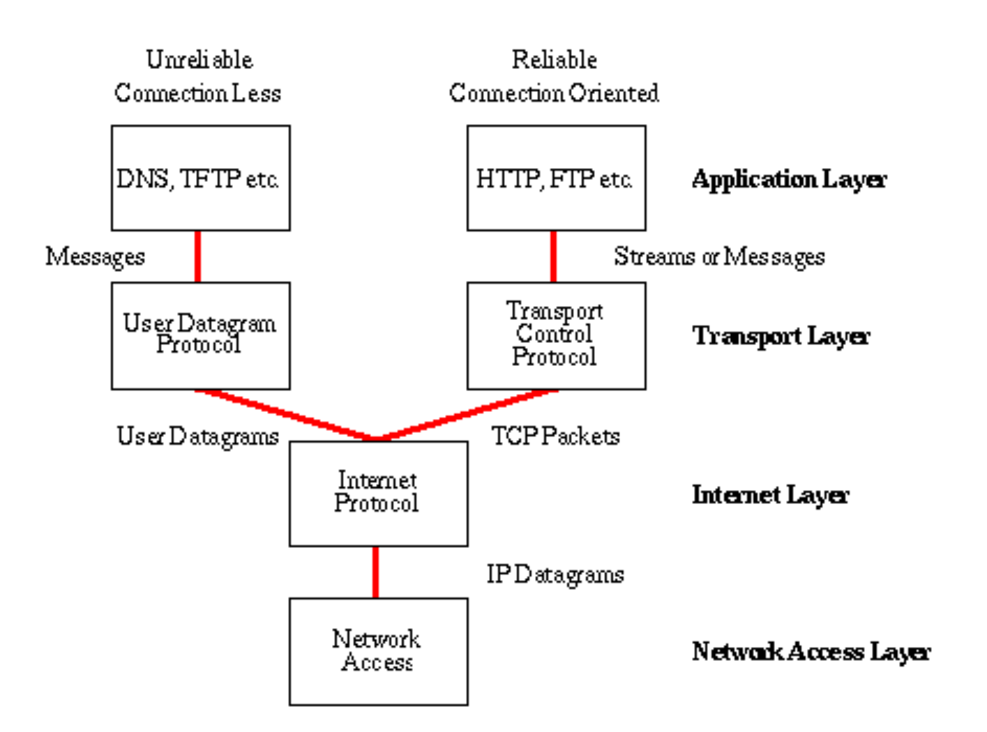
The Internet
The Internet [link]
IP (Internet Protocol) [link]
TCP (Transmission Control Protocol) [link]
TCP/IP
UDP (User Datagram Protocol) [link]
UDP/IP
TCP/IP or UDP/IP Socket [link]
TCP and UDP Protocols & Port Numbers [link]

